Slide 1



WELCOME

Slide 2
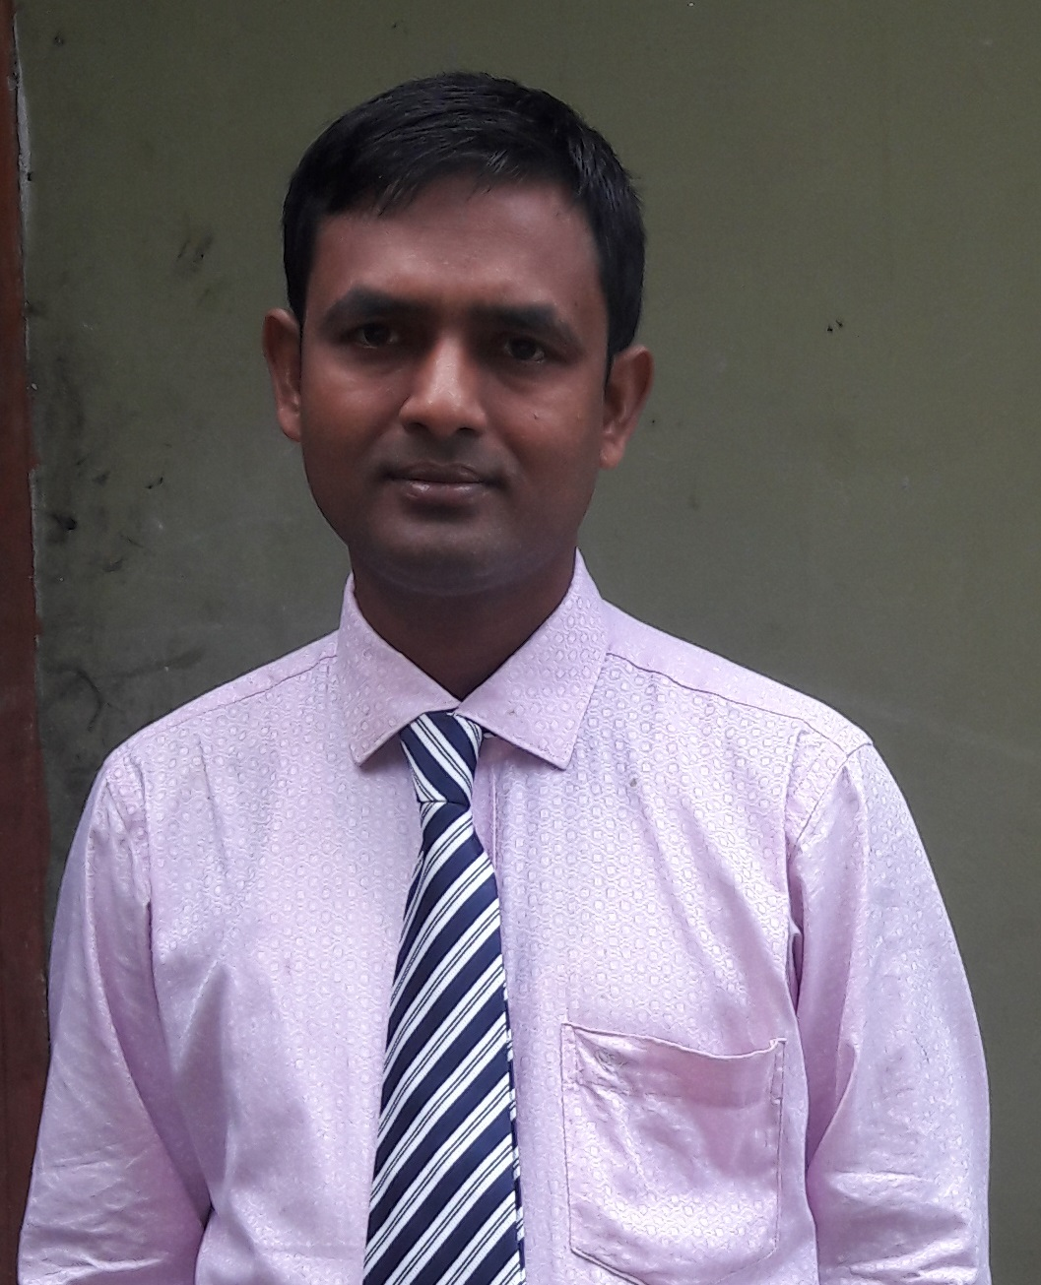
MUHAMMAD NOORE ALAM
Assistant teacher
Chandgaon Government Primary School
Laksam, Comilla.
E-mail: noorealam19797@gmail.com
Contact No.: 01712-392593

Slide 3
Today’s Lesson
What do they do?
Class: Three
Subject: English
Unit: 23
Lesson: 1
Lesson Part: A (Listen and say)

Slide 4
Learning Outcomes
Listening
1.1.1-recognize English sound differences in the
context words.
Speaking
1.1.1-repeat words, phrases and sentences
after the teacher with proper sounds and stress.
1.1.2-say words, phrases and sentences
with proper sounds and stress.

Slide 5
Let’s watch a video.

Slide 6
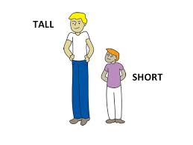
Lesson Declaration
What do you see in the picture?
Today we will learn some word and their opposite word.
Tall
Short

Slide 7



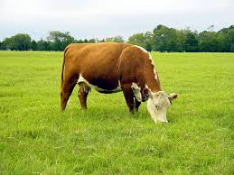

Presentation
10 minutes

Slide 8

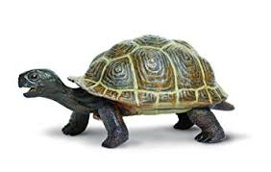
Quick
Slow
The hare is quick.
The tortoise is slow.

Slide 9

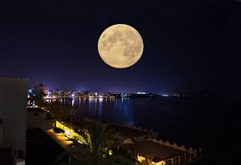
Early
Late
She gets up early in the morning.
She sleeps late at night.

Slide 10

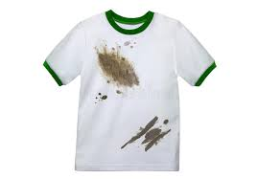
Clean
Dirty
This is a clean shirt.
This is a dirty shirt.

Slide 11
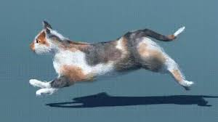
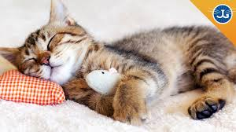
Active
Lazy
The cat is active in the afternoon.
The cat is lazy in the morning.

Slide 12
20 min.
Practice

Slide 13
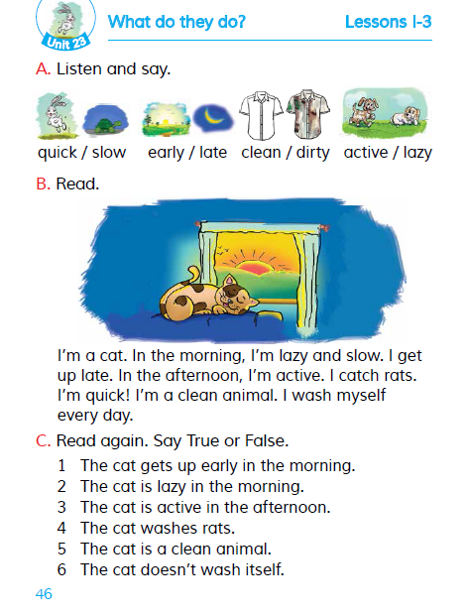
Student’s loud reading
Open your book at page 46.

Slide 14
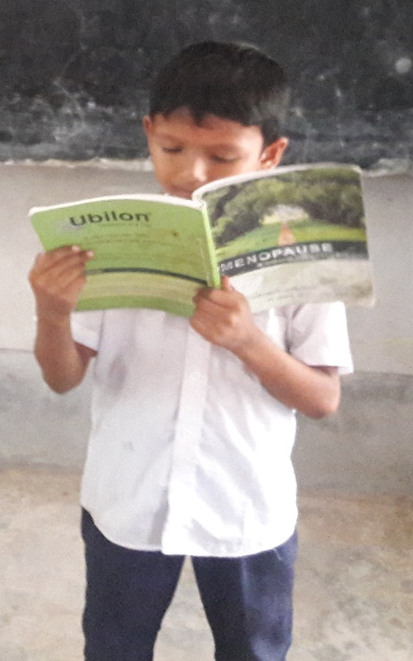
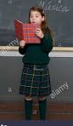
Quick
Slow
Late
Early
Lazy
Clean
Active
Dirty

Slide 15
Matching
I.W.
5 Min.
Quick
Dirty
Early
Lazy
Clean
Slow
Active
Late

Slide 16
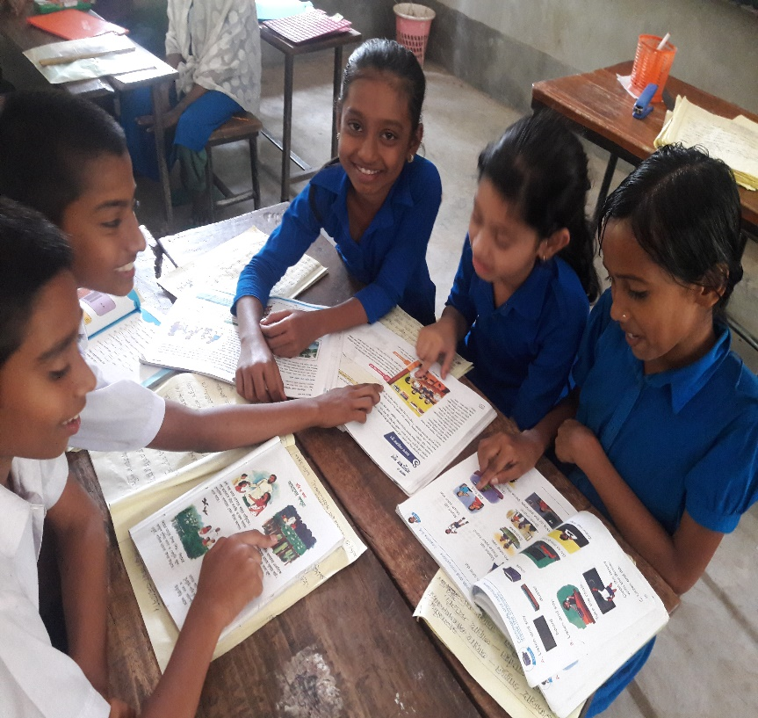
Making Sentences
Group work

Slide 17
Sample Ans.
G-A
Quick
The hare is quick.
G-B
Lazy
She is lazy.
5 min.
G-C
Clean
My shirt is clean.
G-D
I am active.
Active

Slide 18

SEE YOU TOMORROW

